Slide 1
Unit 10
Measures of Central Tendency and Dispersal of Data
Algebra 1

Slide 2
MEAN
Mean is the average value of all data in a set.
Add up the numbers then divide by the number of values in the set to find the mean.
Example: Find the mean of the following:
{66, 72, 83, 89}

Slide 3
Median
The median is the value that has exactly half the data above it and half below it.
Example: Find the median of the following:
{65, 72, 81, 83, 89}
Example: Find the median of the following:
{65, 72, 76, 80, 83, 89}

Slide 4
Mode
The mode is the number that appears most often in the set.
Example: Find the mode of the following:
{65, 65, 71, 72, 81, 83, 83, 83, 89}

Slide 5
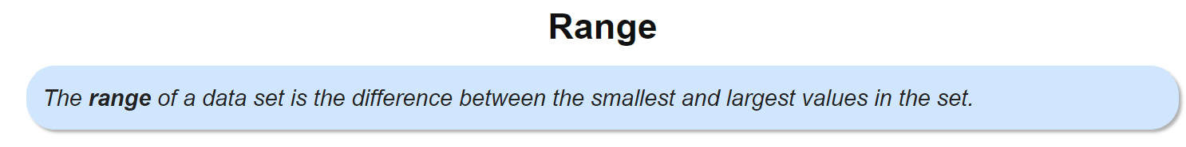
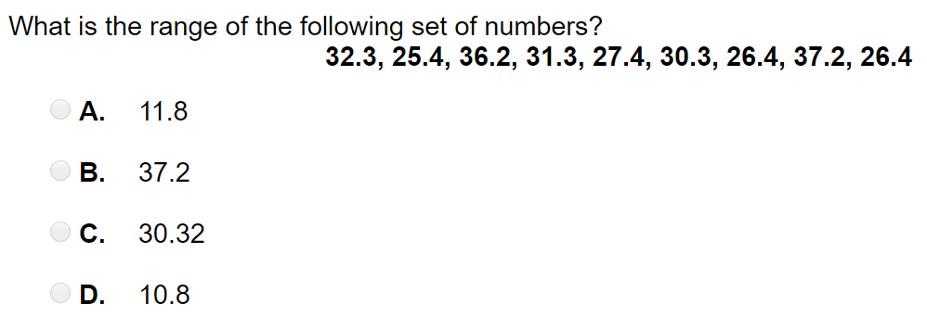
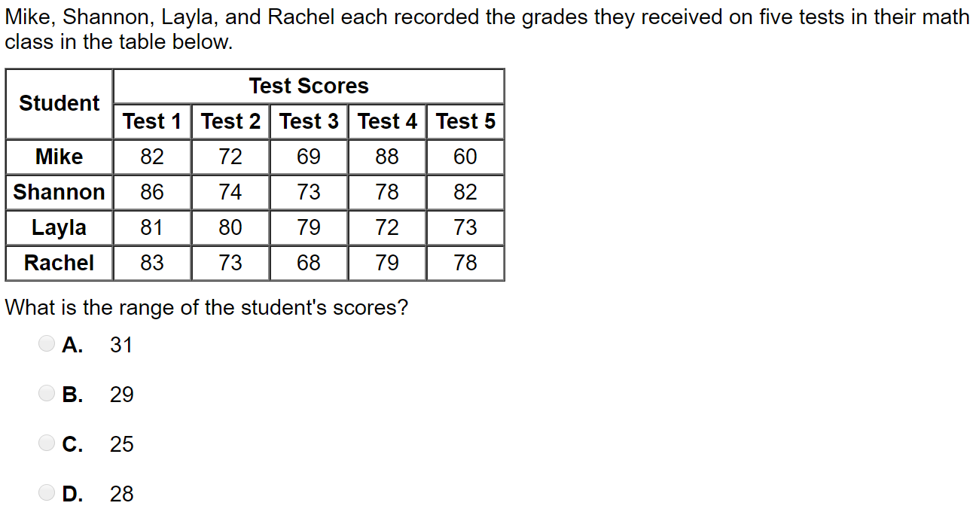

Slide 6
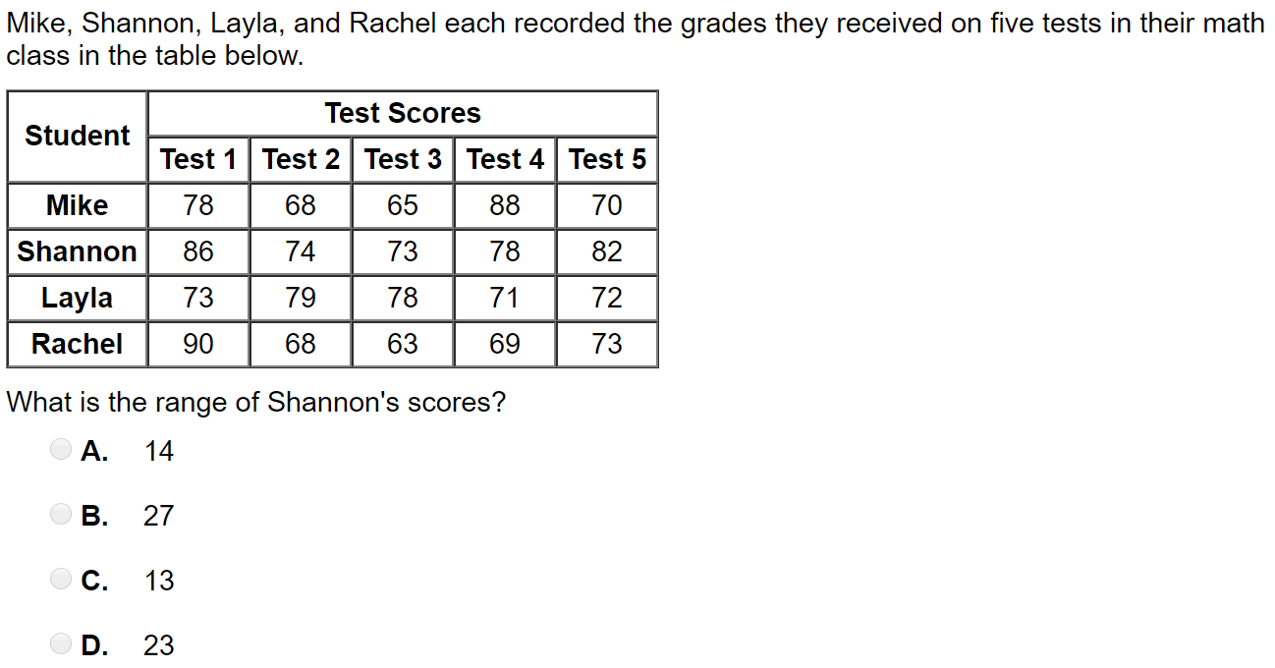
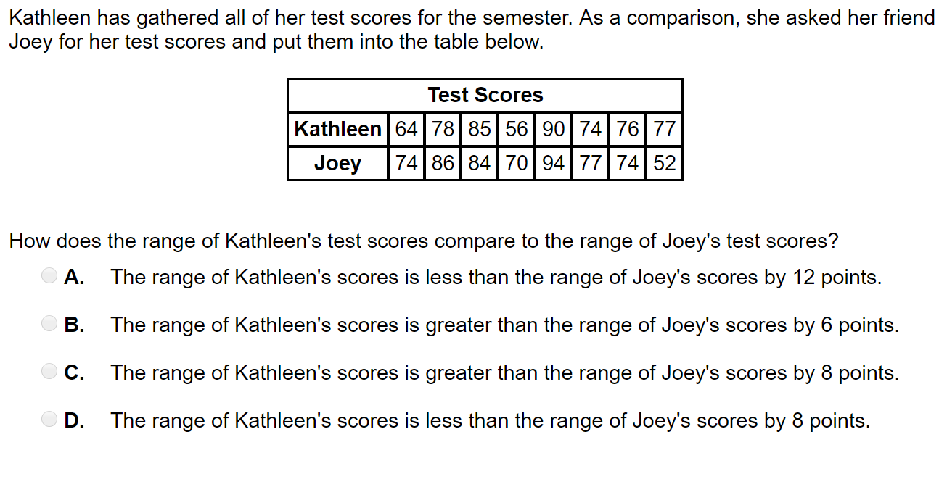

Slide 7
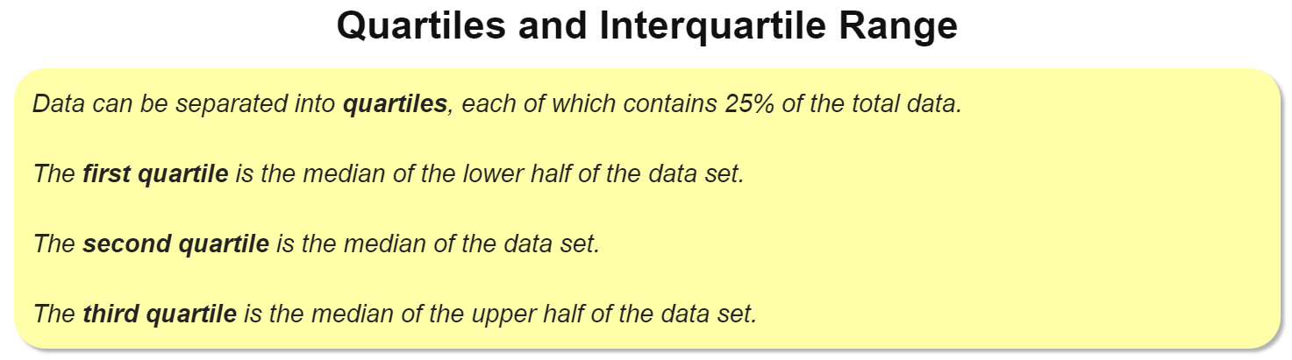
Example:
{60, 65, 70, 75, 76, 78, 80, 83, 85, 87, 90}

Slide 8
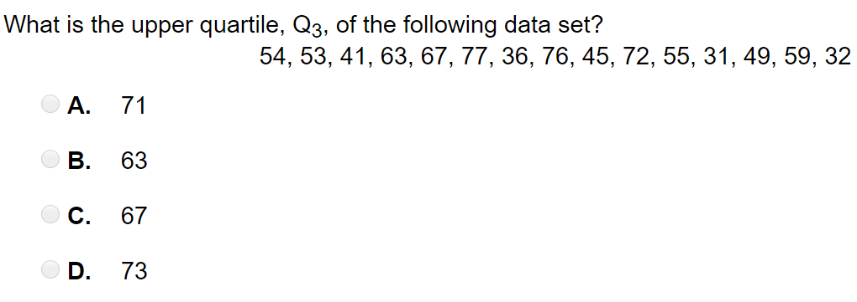
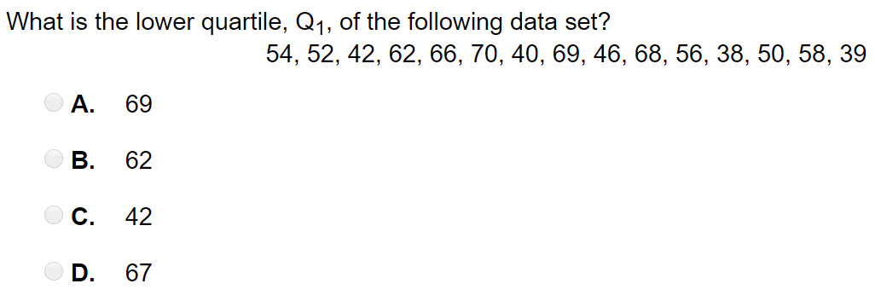

Slide 9
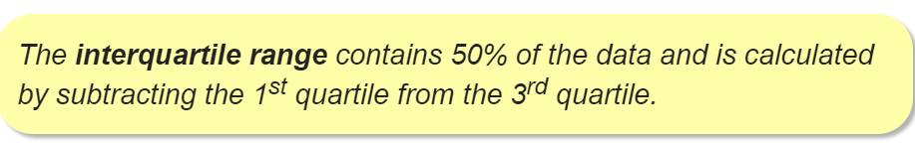
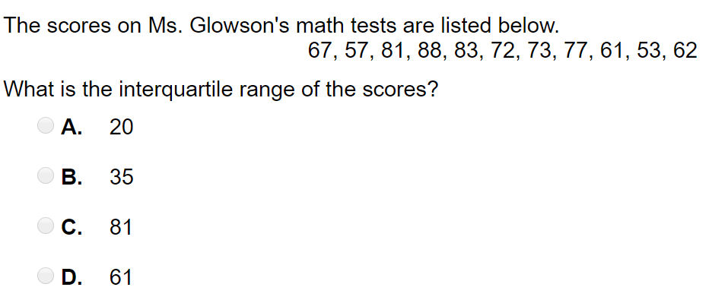

Slide 10
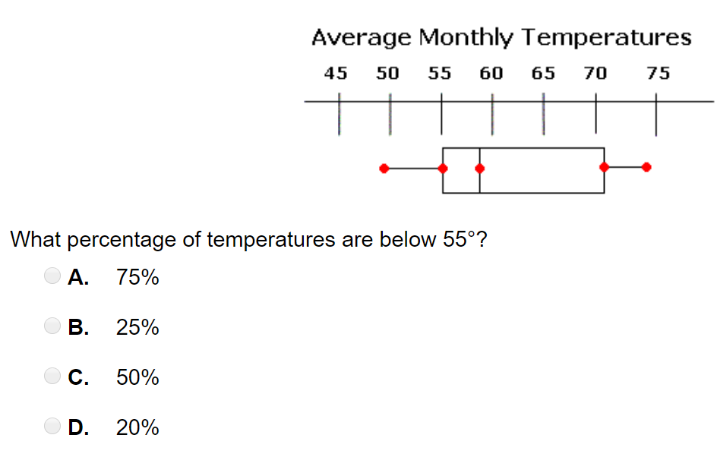
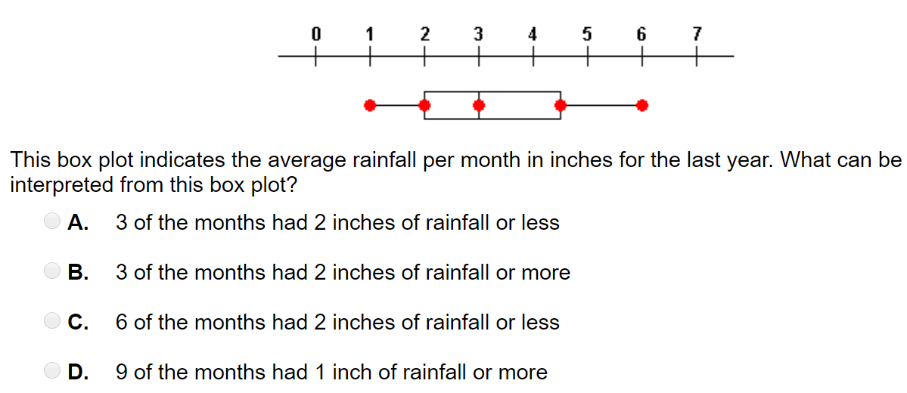

Slide 11
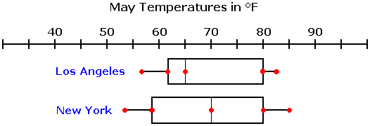
Which city had a higher median temperature in May and by how many degrees?

